Slide 1
Appointment booking
Chatbot Project

Slide 2
Motivation of the Project
Integrating Generative AI solutions is a big challenge in the healthcare industry given the serious risks of hallucinations, particularly when it comes to incorrect medical advice and its potentially harmful consequences. As the generative AI space continues to evolve, it’s crucial to identify use cases where this technology can be applied safely and effectively.
One such opportunity lies in automating administrative tasks within the healthcare industry, where the impact of hallucinations is significantly less critical than in clinical decision-making.
This project presents a prototype of an appointment-scheduling chatbot for healthcare, leveraging FHIR API data to facilitate safe and efficient appointment booking for patients .

Slide 3
Data Source
Since medical healthcare records are confidential, accessing real FHIR data from hospitals posed a significant challenge. To simulate realistic interactions with FHIR data, we used Synthea to generate synthetic FHIR-compliant patient records.
Data source structure:
We created 20 patient file bundle resource files. Each patient file has:
One Patient resource
Multiple Encounter resources (doctor visits)
Multiple Condition, Observation, MedicationRequest resources associated to the patient (which are ignored as not relevant for current project).
Organization(hospitals) and Practitioners(doctors) resources linking the patient Encounters to the hospital and doctor.

Slide 4
Data Preprocessing Module
In the data_preprocessing module we have custom python scripts to extract our desired data from each resource and store them in relational tables
extract_patients.py(Patient Resource):
Primary ID: The patient's unique FHIR ID (patient_fhir_id).
Demographics: First Name, Last Name, Prefix, Date of Birth, Gender, and Marital Status.
Identifiers:
  Social Security Number (SSN)
  Driver's License Number
  Passport Number
  Medical Record Number (MRN) and its associated system.
Contact Information: Home Phone, Full Address (line, city, state, postal code).
Additional Details: Mother's Maiden Name and Birth Place (extracted from FHIR extensions), and preferred Language

Slide 5
extract_patients.py(Encounter Resource):
Primary ID: The encounter's unique FHIR ID.
References (Foreign Keys):
  The Patient's ID (from the subject field).
  The Practitioner's NPI (from the participant field).
  The Hospital's ID (from the serviceProvider field).
Visit Details: The start and end time of the visit (period), and the type of encounter (e.g., AMB for ambulatory, IMP for inpatient).
extract_hospitals.py (Organization Resource):
Primary ID: The hospital's unique FHIR ID (hospital_fhir_id).
Identifiers: The Synthea-generated ID, used for mapping purposes.
Details: The hospital's Name, Phone Number, and full Address.

Slide 6
extract_practitioners_and_roles.py
Primary ID: The doctor's NPI (National Provider Identifier), which we use as the primary key.
Details: First Name, Last Name, Prefix, Gender, and Email.
Location: The practitioner's primary Address.
practitioner_roles resource: Randomly assigns a specialty to each practitioner.
schedules & slots resource: Creates a future calendar of availability for each practitioner.
appointments_table: Created at inference time to record a new booking linking a patient to a slot.
main_processor.py:
Driver function that invokes the extraction scripts and stores to relational DB

Slide 7
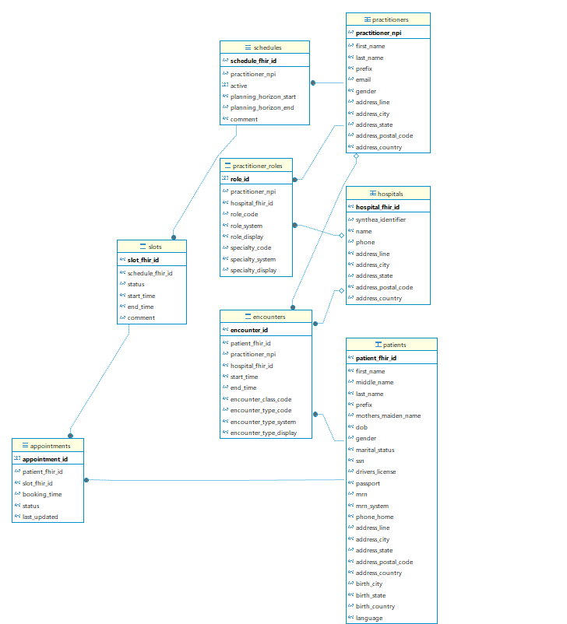
ER diagram(Dbeaver)

Slide 8
Practitioner-Centric Relationships
One practitioner can have one or more schedules. (although code currently creates only one schedule per practitioner, but the database schema allows for more).
One practitioner can have many roles.
One practitioner can be associated with many historical encounters.
Hospital-Centric Relationships
One hospital can be the location for many practitioner roles.
One hospital can be the location for many historical encounters

Slide 9
Patient-Centric Relationships
One patient can have many appointments.
One patient can have many historical encounters
Scheduling and Appointment relationship
One schedule (belonging to a doctor) is made up of many individual slots.
One slot can be linked to many appointments. In the code however we have a unique constraint enforced in the appointments table that each slot_fhir_id must be unique thus making it a one-to-one relationship.

Slide 10
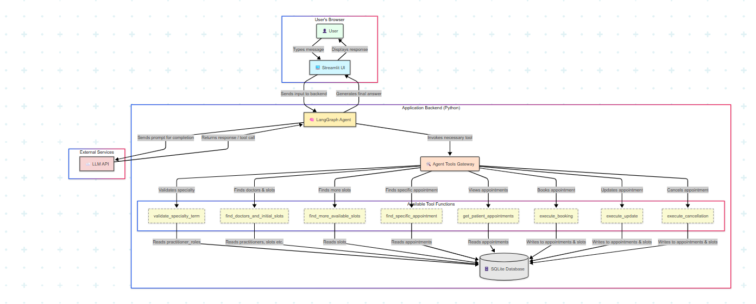
System design Architecture

Slide 11
Future Work and Integrations
Integrate Google Calender API with current chatbot.
Integrate Gmail API so that appointment confirmation details can be sent.
If provided access to real-time Medical Health care records then we can setup a Kafka(if there are frequent changes to schedules) or a cron job that updates the database on a defined time basis. Current time slots are static and are created when triggering the data processing driver script.
Improve UX so that when LLM displays slots to create, update or cancel a meeting ,there is an option to click the slots to trigger the action. Current limitation needs user to copy paste the slot into the chat.

Slide 12
Relevant Links and helpful references
Project links:
Github : https://github.com/hari7878/Appointment-chatbot-booking-system/tree/main
Docker image of project deployed in GCP: https://healthsched-app-544904450498.europe-west1.run.app/
FHIR references
https://build.fhir.org/bundle.html
https://build.fhir.org/patient.html
https://build.fhir.org/encounter.html
https://build.fhir.org/organization.html
https://build.fhir.org/practitioner.html
https://build.fhir.org/practitionerrole.html
https://build.fhir.org/schedule.html
https://build.fhir.org/slot.html

